Slide 1
The debate at MUNOL (according to the sixth edition of the RoP)
The Secretaries General of MUNOL 2019

Slide 2
United Nations
International organisation
Nations as members
Founded after WWII
Shall ensure peace all over the world
Different forums/assemblies

Slide 3
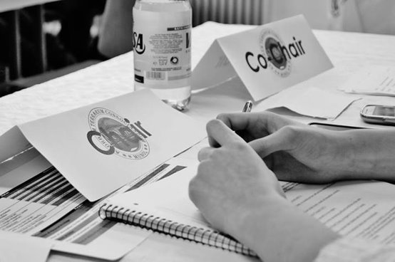
Participants
Chair/Presidency
Leading the debate
Experts for the issue
Delegate
Representing a nation or organization
Writing resolutions, debating them later
Ad-Staff
Supporting/helping the Chairs

Slide 4
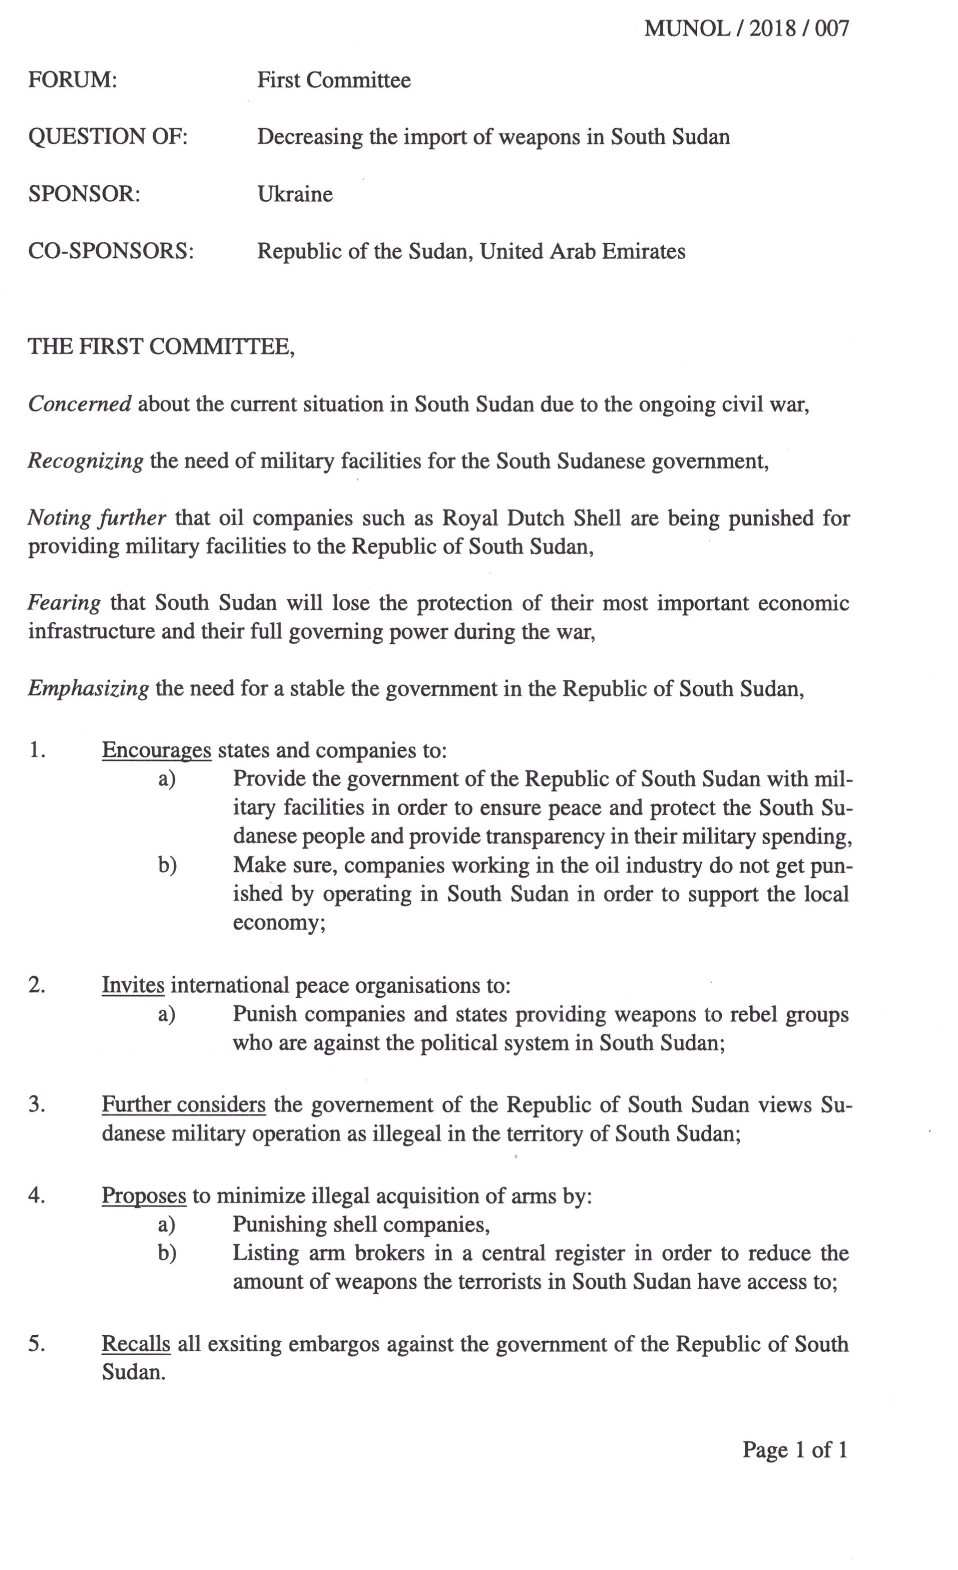
The resolution
Headline (Forum, Issue and Sponsor)
Consists of
Preambulatory clauses (PC)
State facts regarding the issue
Operative clauses (OC)
List measures to be taken
Define important terms
Preambs
OCs

Slide 5
The debate
open debate (possible after voting on)
in favour
against
Lobbying
reading time
voting
amendment
amendment
The debate

Slide 6
The Amendment process
Motion to amend the Resolution
Formal debate in favour/against
AMENDMENT
In favour against

Slide 7
Points and Motions
Points (most important)
Motions (most important)
Point of Information to the Speaker
Point of Order
Point of Personal Privilege
Motion to Move into Time Against
Motion to Close the Debate
Motion for a Right of Reply
Motion to Amend the Resolution
Motion to Follow Up

Slide 8
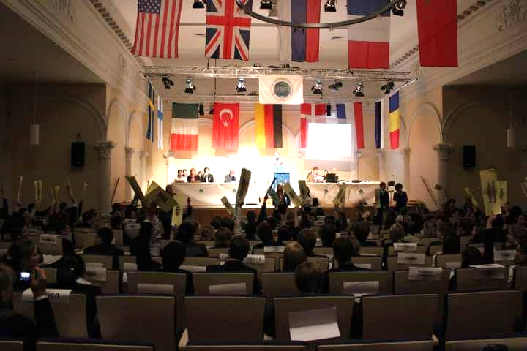
How to participate
Deliver a speech
Ask a Point of Information
Vote
Make useful/necessary points or motions

Slide 9
Thank you for your attention! Are there any questions?

